Slide 1
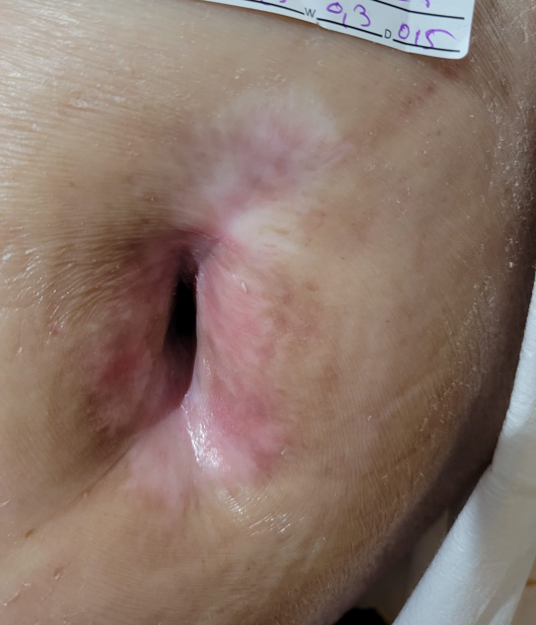
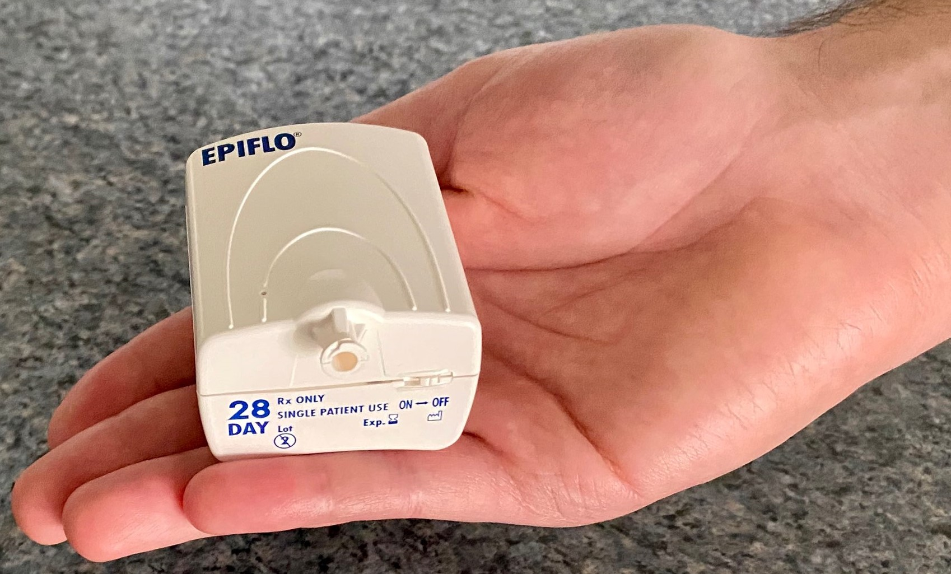
the leader in Oxygen Therapy for your patients…Give your patients the advantage of faster healing and Mobility!
info@ogenix.com
28 days to Success

Slide 2
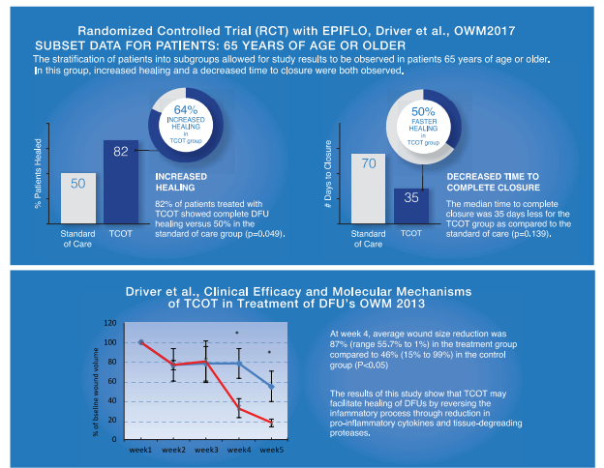
Give your 65 and older patients a chance!
It’s in your hands….Contact us for Info
info@ogenix.com

